Slide 1




Housing Loan Repayment Risk Analysis
Team 21:
Bhavya Parmar 002249226
Darshil Shah 002814137

Slide 2


Objective:
The objective of the project is to develop sophisticated predictive models for enhancing credit risk assessments within the finance industry.
Further more, the models lays importance on the following topics
1. Predictive risk modeling
2. Default prediction accuracy
3. Real-time risk assessment

Slide 3



Motivation:
Problem:
We are solving the problem of accurately predicting loan repayment challenges to improve credit risk assessments in the finance sector.
Need:
The need stems from the requirement to refine and enhance credit risk evaluation methods.
Aims to increase the accuracy of predictions regarding loan repayment risks, thus reducing defaults and stabilizing the financial sector.
Solution:
The solution we are offering involves deploying advanced machine learning models to analyze extensive loan data, improving the accuracy of credit risk assessments

Slide 4
Goal:
Step 1:
Step 2:
Step 3:
Data Preparation:
Consolidating and preprocessing the loan application data, ensuring the accuracy and consistency necessary for model training.
This step involves cleaning the data, handling missing values.
Model Development:
Implementing ML algorithms, such as Decision Trees, Random Forest, and Logistic Regression, to develop models that can predict loan repayment risks.
Model Evaluation and Optimization:
Evaluating the performance of each model using cross-validation techniques and metrics such as accuracy, precision, recall, and AUC-ROC curve.

Slide 5
Important Columns:
Data Description:
Applicant Financial Background: Contains data on income, debts, and financial health to assess loan repayment capability.
Employment Status: Indicates whether the applicant is employed, unemployed, self-employed, or retired, providing insights into their stable income sources.
The dataset comprises detailed loan application data, including applicants' financial background, employment status, family circumstances, loan specifics, and credit history, used for predictive modeling in credit risk assessment.
Family Circumstances: Includes data on marital status, number of dependents, and living situation.
Loan Amount: The total amount of money requested by the applicant.
Annuity: The regular payment amount the applicant is obligated to pay towards the loan.
Type of Loan: Specifies the loan's purpose, such as mortgage, personal loan and auto loan.
Repayment Terms: Details of the length of the loan and any specific repayment conditions.

Slide 6

Methodology:
Data Preprocessing and Cleaning
Model Selection and Evaluation
Feature Engineering
Exploratory Data Analysis
Cross-validation

Slide 7
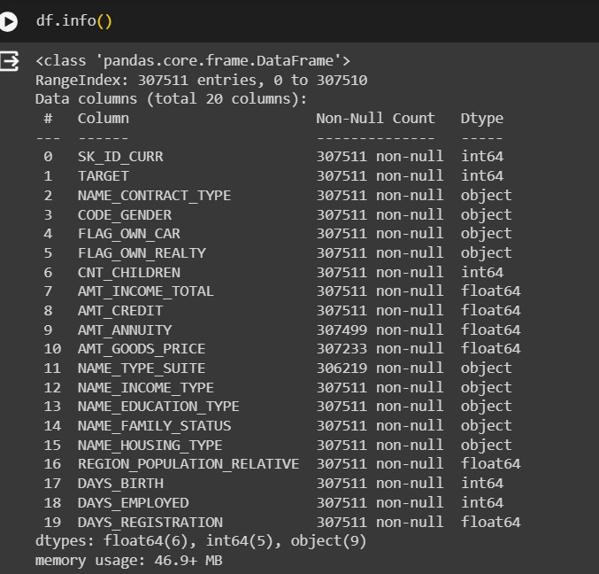
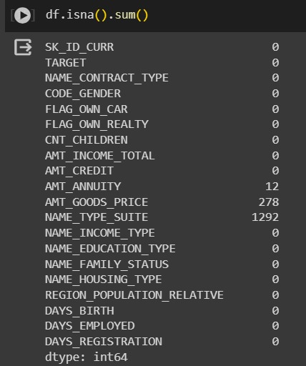
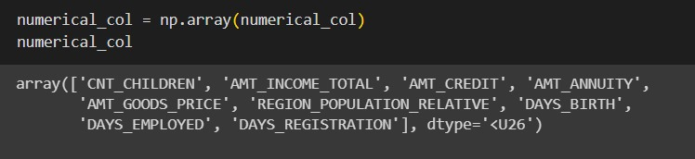
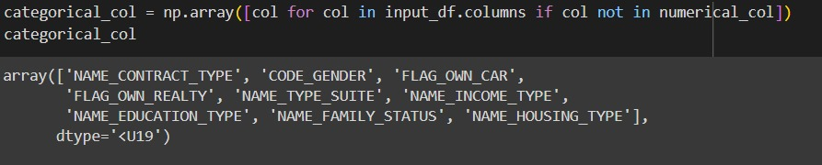
Numerical columns in dataset
Description of columns & rows in dataset
Missing values in respective columns
Categorical columns in dataset

Slide 8
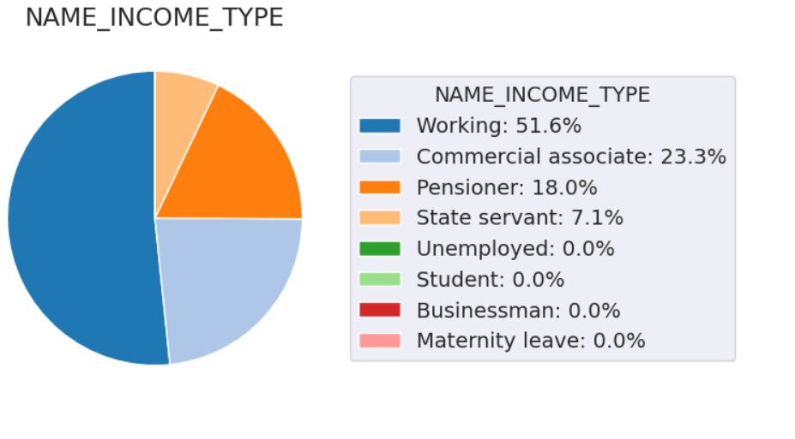
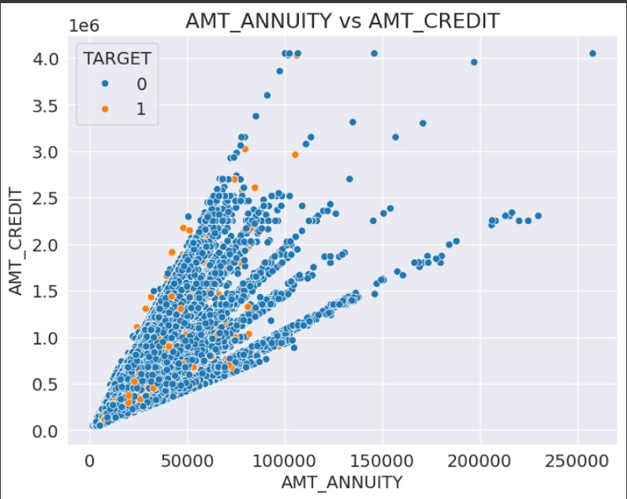
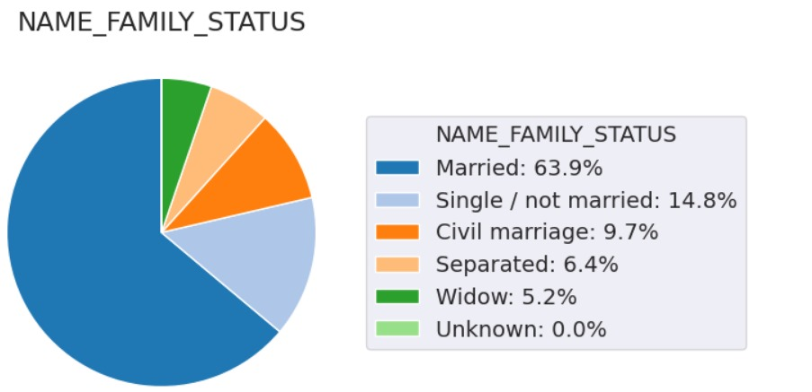
Data Analysis:

Slide 9
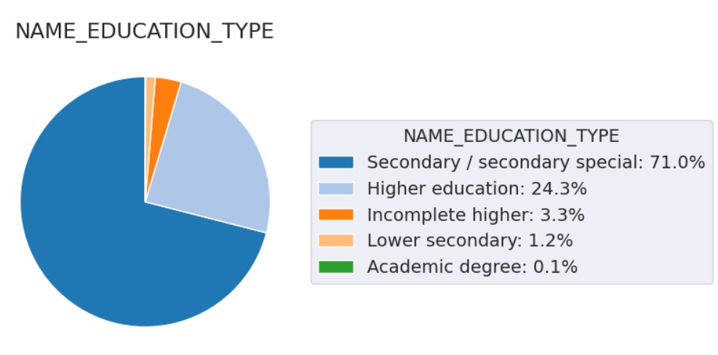
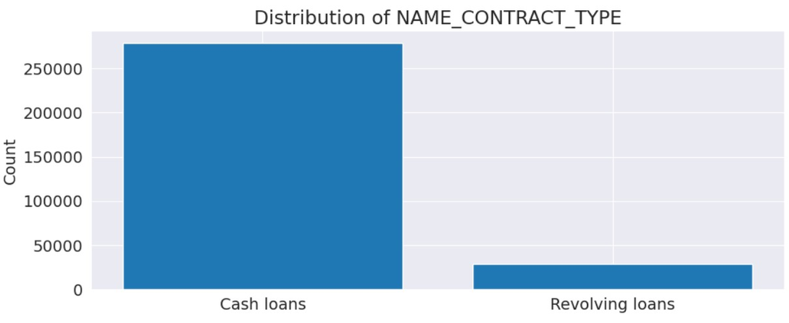
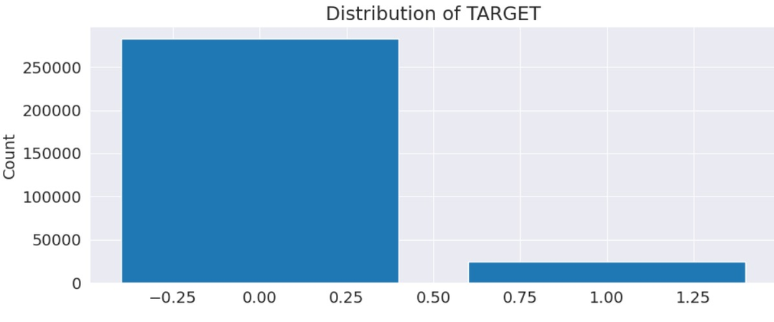
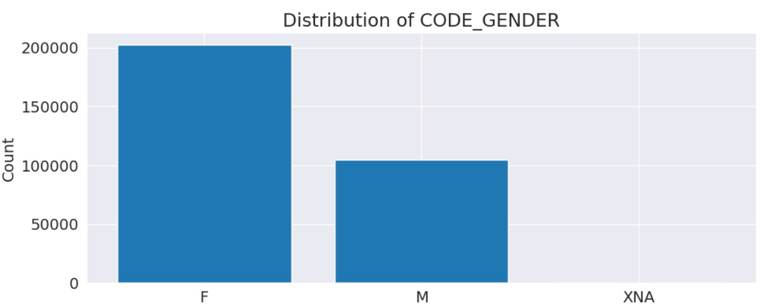
Data Analysis:

Slide 10
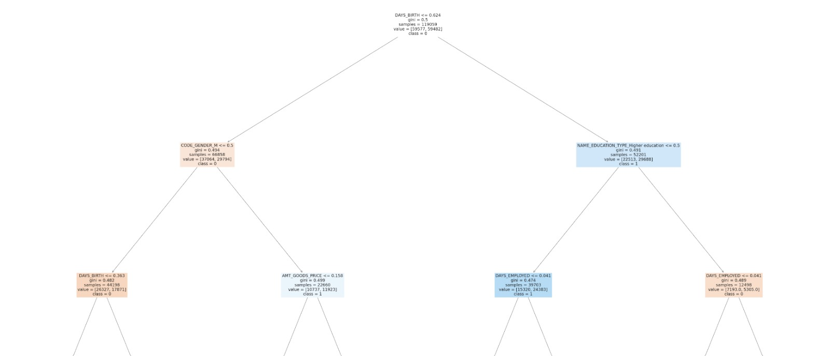
Decision Tree:

Slide 11
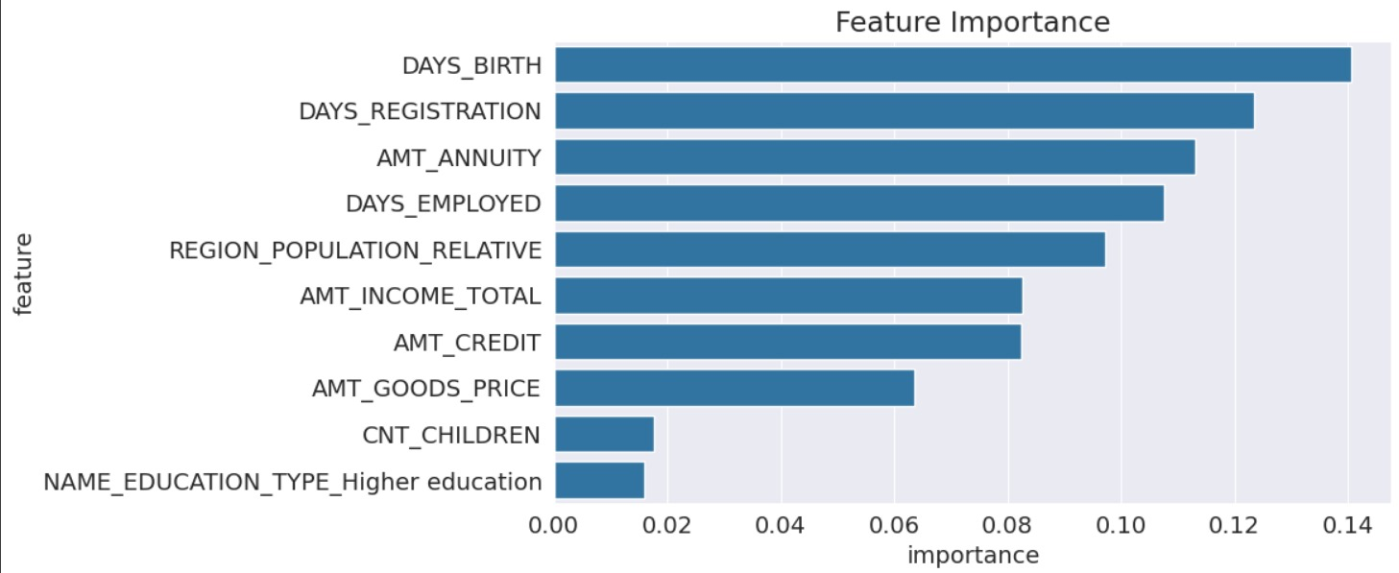
Random Forest : Feature Importance

Slide 12
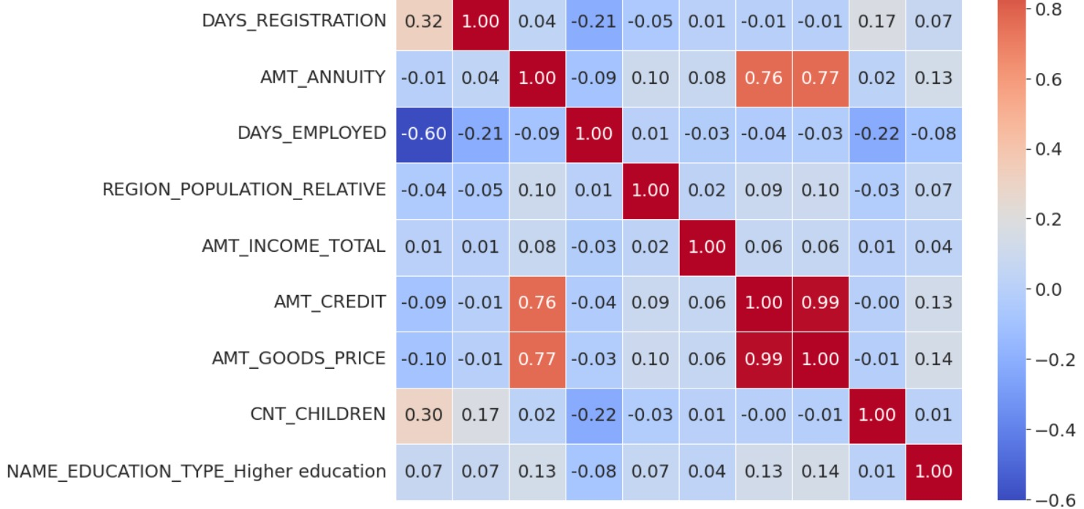
Confusion Matrix:

Slide 13
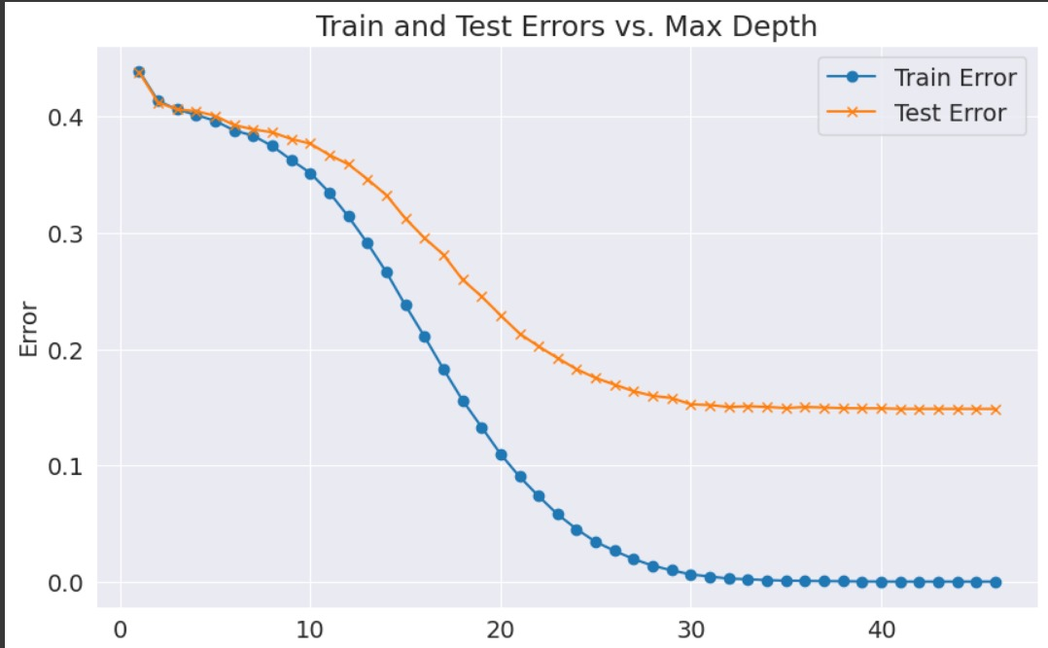
Validation Curve:

Slide 14
Models Used:
Logistic Regression:
Random Forest
Decision Tree:
Serves as a statistical method to predict the likelihood of loan default by evaluating various financial indicators from the applicant’s background.
The model considers income levels, debt ratios, and overall financial status to estimate the probability that a borrower will fail to repay a loan.
To enhance the accuracy of predicting loan repayment risks. This ensemble learning method utilizes multiple decision trees to analyze the applicant's financial data, including income
Each tree in the forest makes a prediction about the loan default risk, and the final outcome is determined by majority voting or averaging these predictions.
To model the probability of loan defaults based on comprehensive financial and demographic data of applicants. This method breaks down the dataset into smaller subsets using a tree-like model of decisions and their possible consequences. Each node in the tree represents a decision point where a split is made based on a specific attribute.

Slide 15
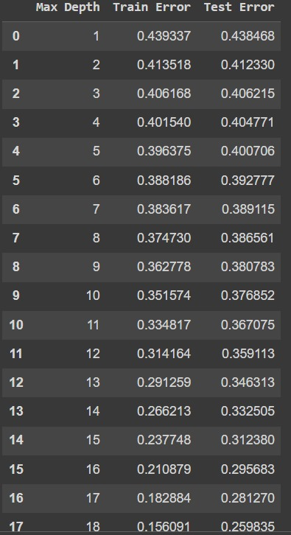
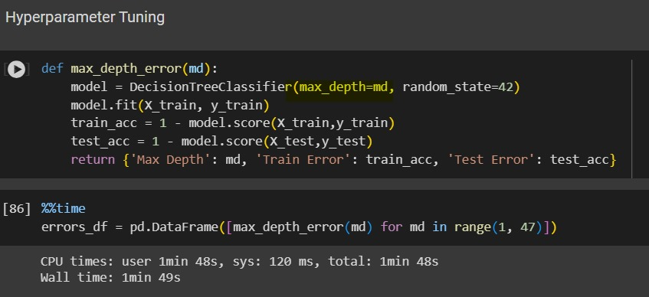
Hyper Parameter Tunning : Decision Model
Hyperparameter tuning for an Decision model optimizes its performance by methodically testing combinations of key parameters like max_depth through supported by cross-validation.
This iterative process fine-tunes the settings to maximize metrics such as accuracy.
The best parameter set is then used to train the model, significantly enhancing its ability to generalize and predict new data accurately.

Slide 16
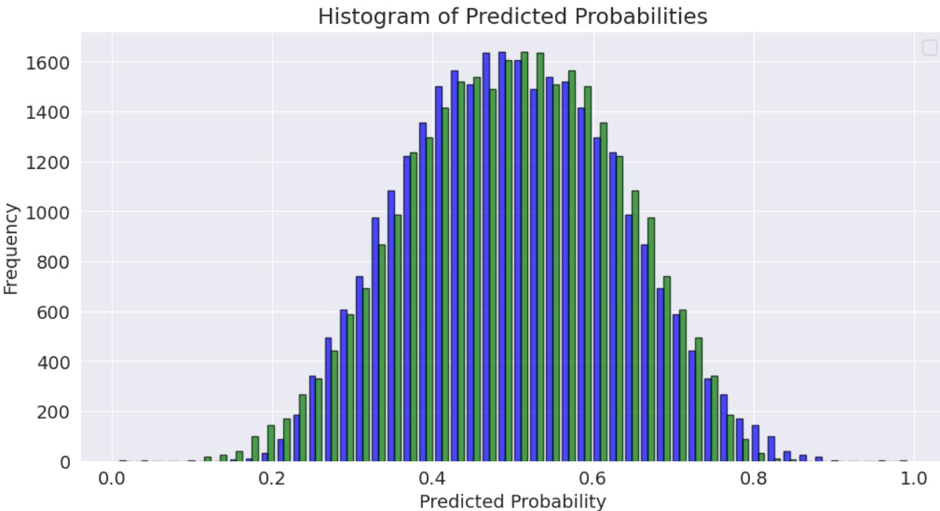
Histogram of Probabilites:

Slide 17
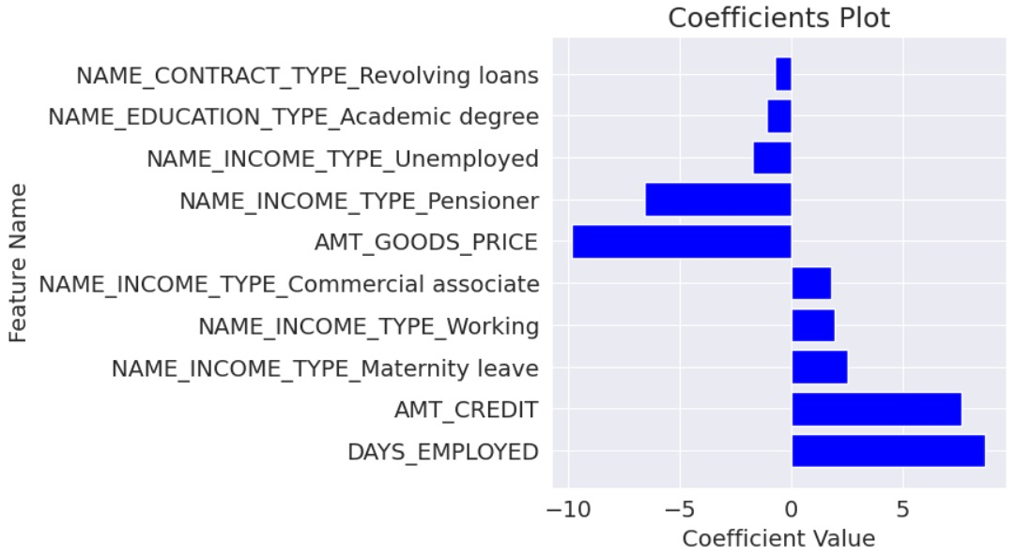
Logistic Regression:

Slide 18
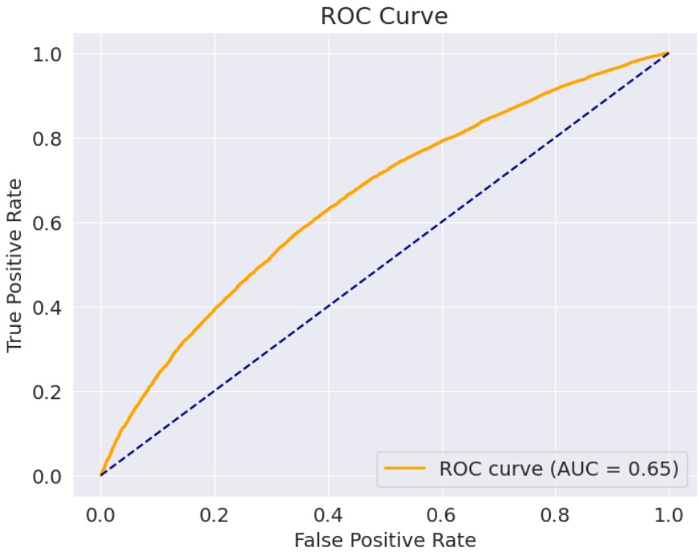
ROC Curve:

Slide 19
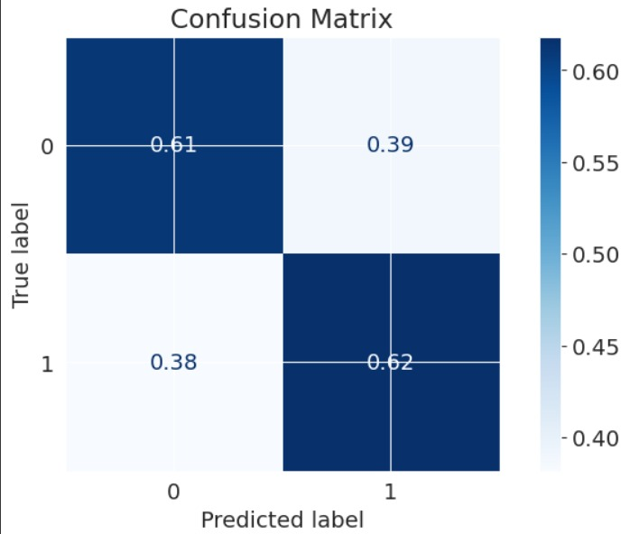
Confusion Matrix:

Slide 20
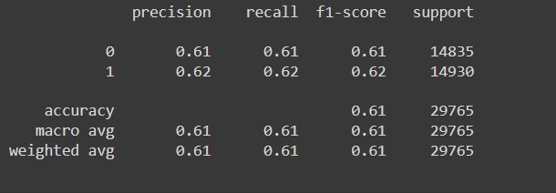
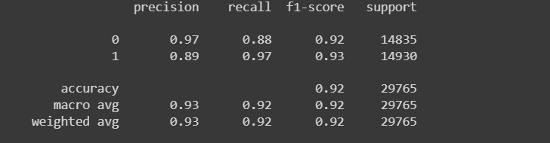
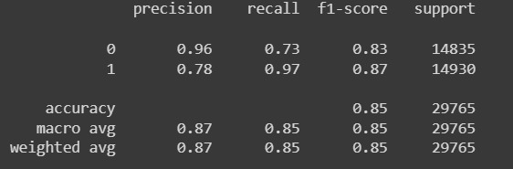
Logistic Regression:
Random Forest:
Decision Tree:

Slide 21

Reference

Slide 22









Thank You :)

